Slide 1



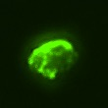
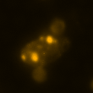
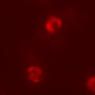
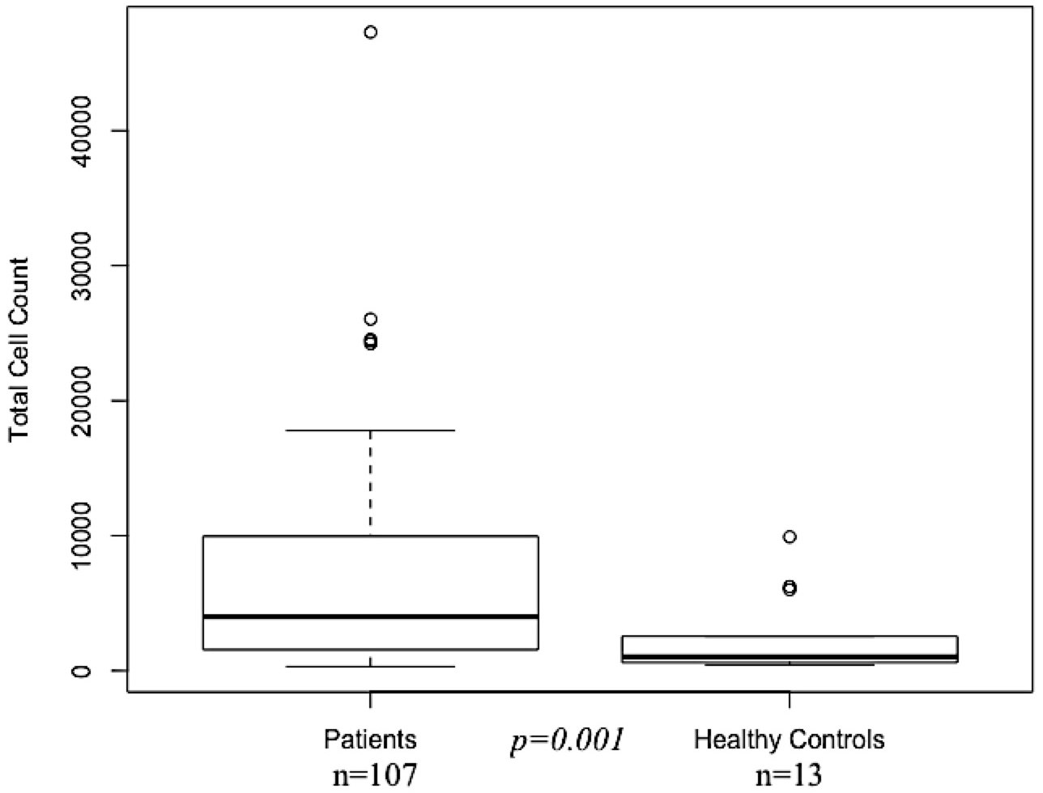
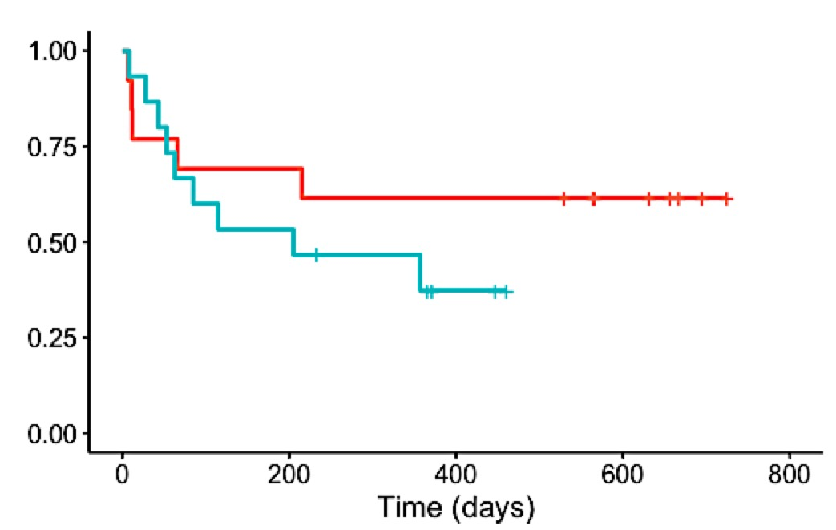
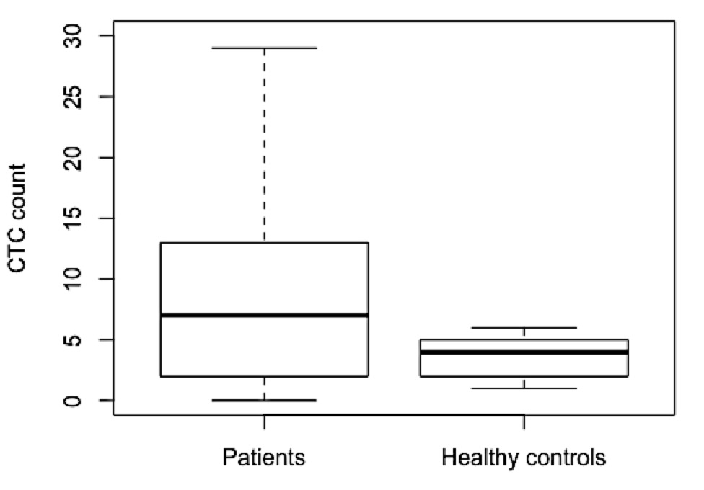
Evaluation of Circulating Tumour Cell Count in Non-small Cell Lung Cancer
Insert school logo here
if applicable
First Name LAST NAME IN CAPS and Co-Authors
Institute of Bioengineering and Nanotechnology, 31 Biopolis Way, The Nanos, Singapore 138669
INTRODUCTION
MATERIALS AND METHODOLOGY
Text
Text
Fig. 1 Synthesis of.
DAPI+
CK+
VIM+
CD45-
RESULTS AND DISCUSSION
CORRELATION BETWEEN CTC COUNT AND MUTATIONS DETECTED
ASSOCIATION BETWEEN CTC COUNT AND TREATMENT RESPONSE
There is no significant difference between the mean CTC count of different EGFR mutations (p = 0.516) and presence of T790M (p=0.693). No correlation is seen between CTC count and the level of EGFR mutation (p = 0.555) and T790M (p = 0.629) detected in circulating-tumour DNA (ctDNA).
Differences in mean CTC count of mutation types and level detected in ctDNA
ASSOCIATION BETWEEN CTC COUNT AND TREATMENT RESPONSE
p=0.516
p=0.693
The changes in CTC count in some patients complies with the changes in tumour size after treatment. (See examples on the left)
Examples where changes in CTC count in patients agree with treatment responses
n=3
n=1
n=47
n=21
n=6
n=66
PR
PR
PD
PD
p=0.555
p=0.629
Changes in CTC count and frequency of treatment responses
Change in CTC count | CR/PR | SD | PD
Decreased | 37.0% | 33.3% | 29.7%
Unchanged | 27.3% | 63.6% | 9.1%
Increased | 18.2% | 45.5% | 36.4%
n=52
n=22
n=11
n=14
n=80
n=8
n=13
n=4
CR/PR: decreased tumour size after treatment
SD: no/small change in tumour size
PD: increased tumour size after treatment
CELL COUNTS IN PATIENTS AND HEALTHY CONTROLS
PROGNOSTIC SIGNIFICANCE OF BASELINE CTC COUNTS
Cut-off for poor prognosis was set at 6 CTCs. Longer median survival was observed in the group with good prognosis than poor prognosis (454 days vs. 233 days, respectively). Log-rank test shows that the separation is not significant (p=0.340). (See figure on the right)
Kaplan-Meier curve of overall survival of patients with ≤6 and >6 CTC
CK+ VIM- CTCs
≤6 CTCs (n=14)
p=0.007
CK+ VIM+ CTCs
Overall Survival (%)
>6 CTCs (n=14)
n= 28
number of events= 14
p=0.340
n=107
p<0.001
n=13
n=107
n=13
CONCLUSION
FUTURE WORKS
Significantly higher total cell count, CTC count and percentage CTCs expressing only epithelial markers were observed in NSCLC patients compared to healthy controls.
Higher median survival is observed in the patients with lower CTC counts, but the difference is not statistically significant.
Changes in CTC count cannot reliably indicate treatment response.
No significant difference or clear correlation between CTC count and gender, age, clinical stage, EGFR mutation status, presence of T790M and level of EGFR mutation and T790M detected in ctDNA.
Recruit more early stage NSCLC patients and baseline patients
Monitor baseline patients for a longer period (3-5 years)
Molecular analysis on single cells trapped on microsieve to understand their origins
ACKNOWLEDGMENTS
This work was funded by the Institute of Bioengineering and Nanotechnology′s Youth Research Program (Biomedical Research Council, Agency for Science, Technology and Research, Singapore).
REFERENCE
Insert relevant IBN publications, if applicable.

